Slide 1
Manaswini Guntaka
Final Project
3/21/2024 Annual Review

Slide 2
KEYLOGGER AND SECURITY
3/21/2024 Annual Review

Slide 3


AGENDA
• Introduction
• Problem Statement
• Project Overview
• Who Are The End Users
• Solution and Value Proposition
• The "Wow" Factor in Our Solution
• Modelling
• Results
3/21/2024 Annual Review

Slide 4

PROBLEM STATEMENT
• Keyloggers are a significant threat to cybersecurity, leading to unauthorized access to sensitive information , identity theft, and financial fraud.
• Affects individuals, businesses, and organizations by compromising data privacy and security.
3/21/2024 Annual Review

Slide 5

PROJECT OVERVIEW
• Develop a comprehensive understanding of key loggers, their
types, how they work, and effective security measures to
prevent keylogging attacks.
3/21/2024 Annual Review

Slide 6

WHO ARE THE END USERS?
• End users are the individuals within an organization who
interact with various digital platforms, applications, and devices
daily. They are often the first line of defense against cyber threats.
3/21/2024 Annual Review

Slide 7

YOUR SOLUTION AND ITS VALUE PROPOSITION
1. Anti-Key-logger
2. Anti-Virus
3. Automatic form filler
4. One-Time-Passwords
5. Patterns
6. Voice to Text Converter
3/21/2024 Annual Review

Slide 8
YOUR SOLUTION AND ITS VALUE PROPOSITION
1. Anti-Key-logger – As the name suggest these are the software which are anti / against key loggers and main task is to detect key-logger from a computer system.
2. Anti-Virus – Many anti-virus software also detect key loggers and delete them from the computer system .These are software anti-software so these can not get rid from the hardware key-loggers.
3. Automatic form filler – This technique can be used by the user to not fill forms on regular bases instead use automatic form filler which will give a shield against key-loggers as keys will not be pressed .
4. One-Time-Passwords – Using OTP’s as password may be safe as every time we login we have to use a new password.
5. Patterns or mouse-recognition – On android devices used pattern as a password of applications and on PC use mouse recognition, mouse program uses mouse gestures instead of stylus.
6. Voice to Text Converter – This software helps to prevent Keylogging which targets a specific part of our keyboard.

Slide 9

THE WOW IN YOUR SOLUTION
•Innovative Approach: Combining technical measures with user education for
comprehensive protection.
•Demonstration: Real-time demonstration of a simple keylogger to illustrate the threat
and the effectiveness of security measures.
•Impact: Significant reduction in the likelihood of keylogging attacks through proactive
measures.
3/21/2024 Annual Review
9

Slide 10
MODELLING
• Installing Required Libraries
Before we begin, we need to install a particular library, which we can do with the
pip command :
pip install pynput and pip install jsonlib.
• Importing Required Libraries
pynput:
This will help us read the keystrokes as the user types in stuff
JSON is a lightweight data-interchange format. It is often used for exchanging data between a web server
and user agent
3/21/2024 Annual Review
10

Slide 11
• Initialization:
• Set up the main GUI window.
• Initialize global variables for key logging.
• Event Capture:
• Start capturing key events when the "Start" button is pressed.
• Log key press and release events.
• Data Logging:
• Continuously update text and JSON log files with captured key events.
• Stop Logging:
• Stop capturing key events when the "Stop" button is pressed.
• Update the GUI status to indicate the keylogger is stopped.

Slide 12
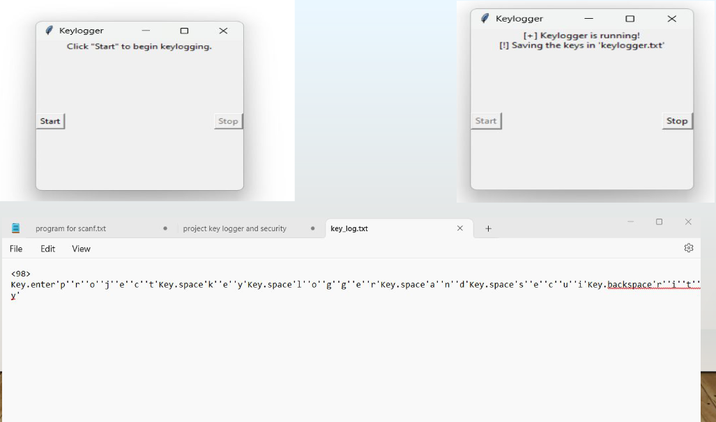
RESULTS
3/21/2024 Annual Review
12

Slide 13
RESULTS
• Successfully implemented a keylogger that captures keystrokes and records them into
both text and JSON files.
• Real-time keylogging with start and stop functionality controlled via a simple GUI.
• The keylogger project demonstrated the capability to effectively capture and log
keystrokes in real-time.
• The GUI provided a user-friendly way to control the keylogger, making it accessible and easy to use.
• Emphasized the ethical use of keyloggers and the importance of implementing security measures to protect against malicious use.
THANK YOU

